Slide 1
0x104.5 – Code Fuzzing
ECED4406 – Computer Security
Dr. Colin O’Flynn
Dalhousie University.

Slide 2
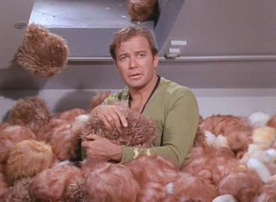
Not that sort of fuzzing…

Slide 3
Basic idea of “Fuzzing”
Put random stuff into computer! See what happens!
Valid error messages not interesting.
Crashes, invalid messages, or unintended behaviors are very interesting.

Slide 4
Simple Example – Web Interface
<Demo>

Slide 5
Types of Fuzzing
Mutation Based
Dumb – random mutations, no regard to format validity (most effort required).
Smart – knows about the data it mutates, but typically not with “feedback”.
Generation Based
Allows to define specific format.
Evolutionary

Slide 6
Mutation Based
Dumb fuzzing less effective as inputs often have some valid checks.
For example – checksum in network protocol.
Smarter mutational fuzzing fixes those “dumb” mistakes such that data is likely to be accepted past first checks.
This approach requires least effort for you.

Slide 7
Generation Based
Inspect the specification itself.
Add errors / changes at specific locations rather than just randomly.
For example – you would know the location of a field such as the file length, file type, etc. Could fuzz each field individually.
This approach requires setup time to understand.

Slide 8
Evolutionary
Generate test cases & watch for output. Change input based on feedback.
Depends on certain information about the target device.
Less Concrete examples in real life – more a research area in practice.

Slide 9
Summary
Fuzzing is a good way of finding bugs in your code.
Simple to randomly insert data to your code – with a little effort can get good coverage of possible likely error conditions!

